Slide 1
BBQ Smoker Grill
By PRI BIO

Slide 2
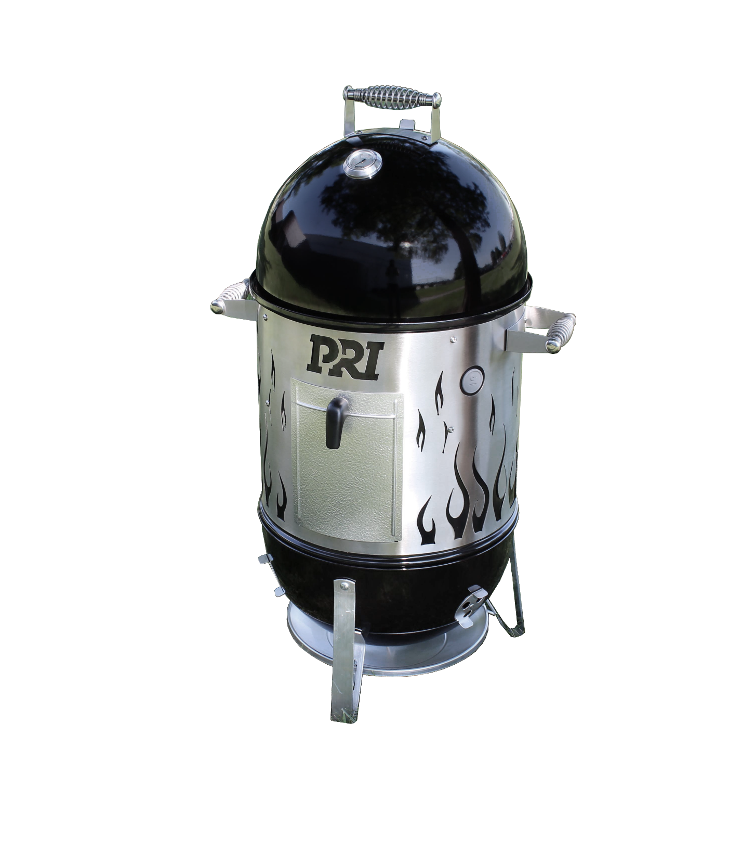
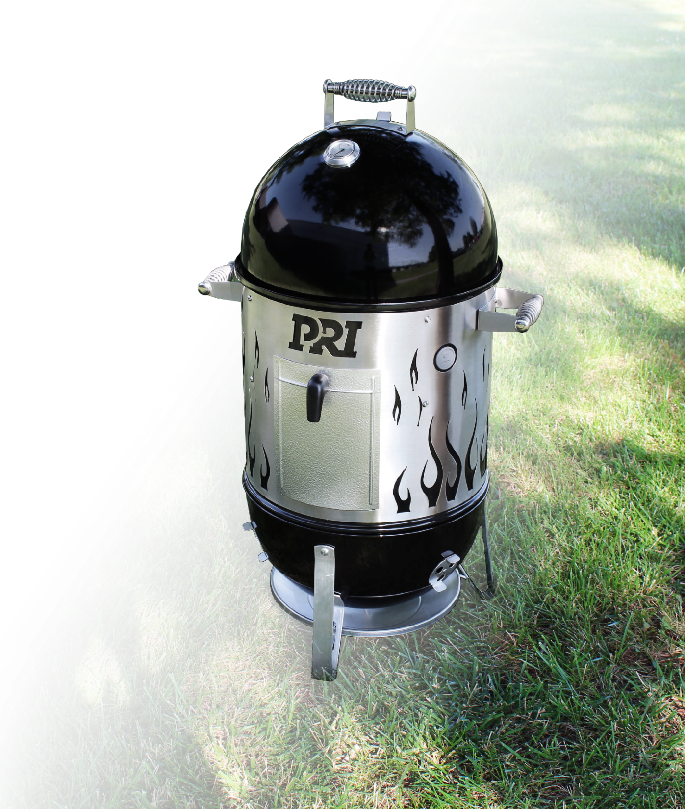
Charcoal BBQ Smoker & Grill: by PRI Bio
The 18” Weber Smokey Mountain Cooker™ smoker has two cooking grates and four aluminum dampers for hours upon hours of consistently low-and-slow. Features porcelain-enameled bowl and lid, two plated steel cooking grates, steel charcoal grate, porcelain enameled water pan charcoal chamber. Total cooking area: 481 sq inches, rust resistant dampers, built-in lid thermometer, rust-resistant aluminum fuel door, premium grade cover included.
Stainless steel flame wrap for extra flare
3 new rugged stainless steel spring handles
3 base dampers and 1 lid damper for precise venting control
Extra tall legs to keep bbq heat off the deck
NOW SAYS AAVLD!

Slide 3
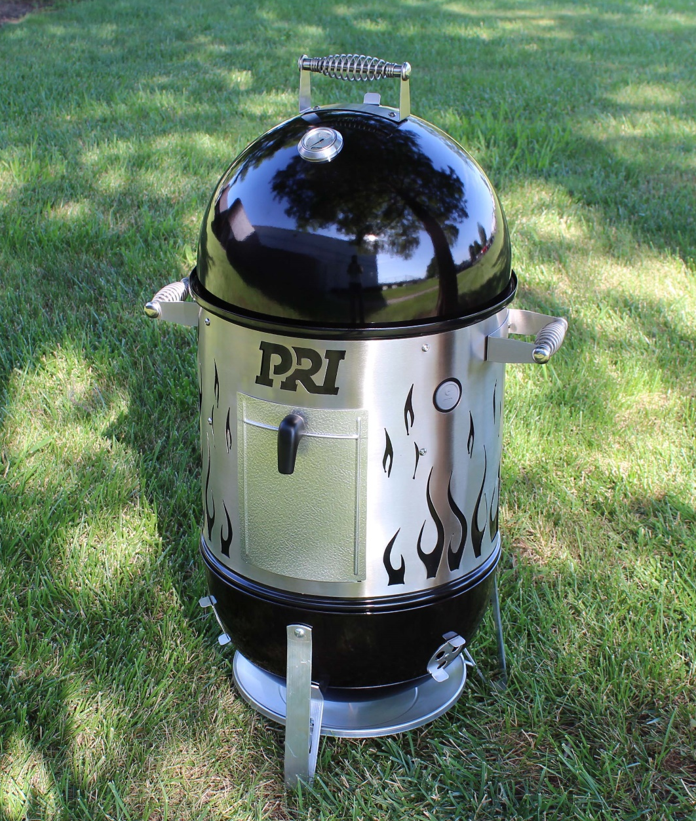
Charcoal BBQ Smoker & Grill: by PRI Bio

